Slide 1
Your SWF – Just the Facts
Neal McNair
Chief Steward and Communications Officer
OPSEU CAAT-A Local 653

Slide 2
Your SWF – Just the Facts
Emphasis on facts and practical information, primarily from Article 11.01 of the C.A.:
How is your workload assigned
How is your total workload calculated and presented on the Standard Workload Form (SWF)
How to review your SWF
What to do if you do not agree with your SWF

Slide 3
Article 11 - Workload
At 14 pages, Article 11 is the longest in the C.A.

Slide 4
Article 11 - Workload
11.01 – Workload assignment and limits, Standard Workload Form (SWF), professional development
11.02 – Workload dispute resolution
11.08 – Non-teaching periods
11.09 – Modified Workload Agreements

Slide 5
Article 11 - Workload
11.01 – Workload assignment and limits, Standard Workload Form (SWF), professional development
11.02 – Workload dispute resolution
11.08 – Non-teaching periods
11.09 – Modified Workload Agreements

Slide 6
11.01 –let’s talk it over
except by voluntary agreement (11.01 D 2 )
the teacher and the supervisor shall agree upon a proportionate attribution of hours. (11.01 E 2 )
supervisor will consult with the affected teachers (11.01 E 3 )
the teacher will discuss the issue with his/her supervisor. (11.01 F 2 )
scheduling shall be at the discretion of the teacher (11.01 G 1 )
additional hours shall be attributed, following discussion between each teacher individually and the supervisor, (11.01 G 2)
Unless otherwise agreed between the teacher and the supervisor..(11.01 H 2 )
subject to agreement between the supervisor and the teacher (11.01 H 3)

Slide 7
Workload process
Workload must be discussed between supervisor and faculty and then detailed on the Standard Workload Form (SWF)
SWF must be assigned no later than 6 weeks before the beginning of the SWF period, not including scheduled vacation time
Once the SWF is received, faculty have 5 days to review and either accept the assigned workload (sign and return), or refer it to WMG for review
After 5 days with no response the SWF is deemed accepted

Slide 8
Assigned workload
11.01 B 1 Total workload assigned and attributed by the College to a teacher shall not exceed 44 hours in any week for up to 36 weeks in which there are teaching contact hours for teachers in post-secondary programs and for up to 38 weeks in which there are teaching contact hours in the case of teachers not in post-secondary programs.

Slide 9
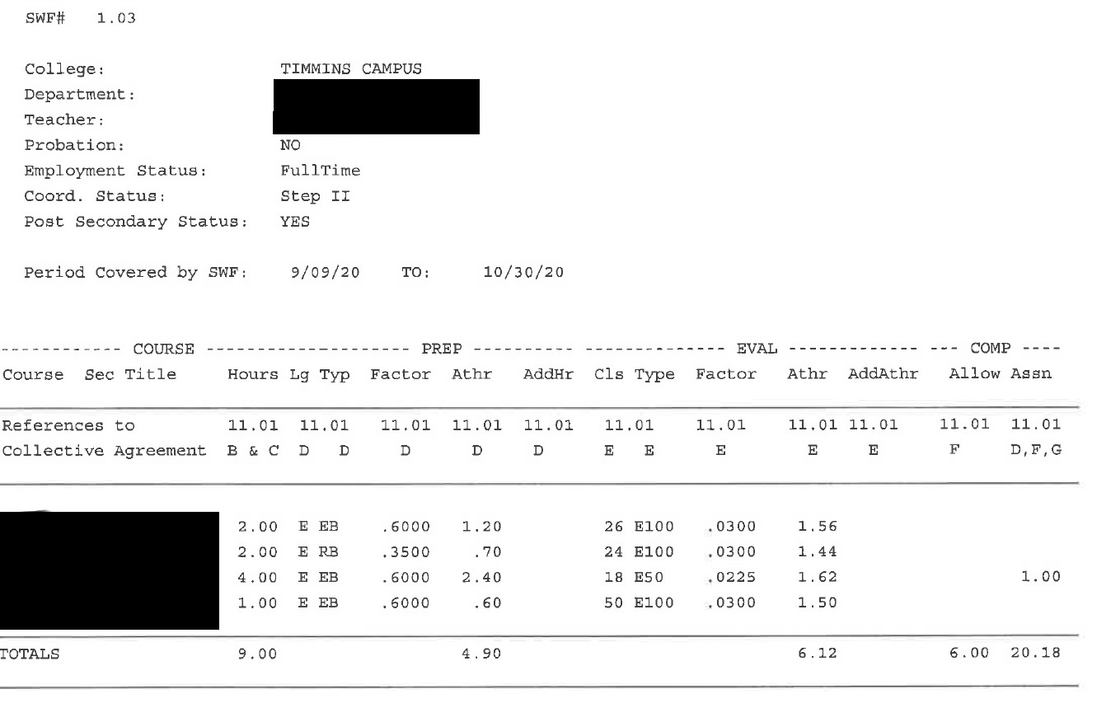
what’s a SWF?
Standard Workload Form used to establish the total weekly assigned work
All, and only, full-time faculty are given a SWF when assigned any teaching contact hours during the academic year.

Slide 10
workload limits
11.01 B 1 Total workload assigned and attributed by the College to a teacher shall not exceed 44 hours in any week for up to 36 weeks in which there are teaching contact hours for teachers in post-secondary programs and for up to 38 weeks in which there are teaching contact hours in the case of teachers not in post-secondary programs.

Slide 11
workload limits
11.01 B 1 Total workload assigned and attributed by the College to a teacher shall not exceed 44 hours in any week for up to 36 weeks in which there are teaching contact hours for teachers in post-secondary programs and for up to 38 weeks in which there are teaching contact hours in the case of teachers not in post-secondary programs.

Slide 12
workload limits
11.01 B 1 Total workload assigned and attributed by the College to a teacher shall not exceed 44 hours in any week for up to 36 weeks in which there are teaching contact hours for teachers in post-secondary programs and for up to 38 weeks in which there are teaching contact hours in the case of teachers not in post-secondary programs.

Slide 13
workload factors
(i) teaching contact hours
(ii) attributed hours for preparation
(iii) attributed hours for evaluation and feedback
(iv) attributed hours for complementary functions

Slide 14
workload factors
(i) teaching contact hours
(ii) attributed hours for preparation
(iii) attributed hours for evaluation and feedback
(iv) attributed hours for complementary functions

Slide 15
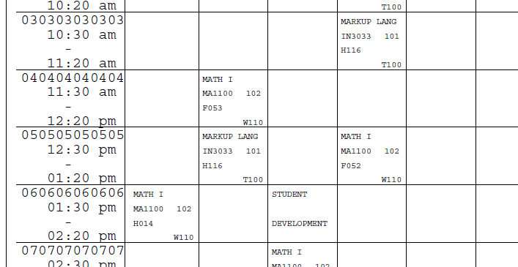
teaching contact hours
11.01 B 2 A “teaching contact hour" is a College scheduled teaching hour assigned to the teacher by the College.

Slide 16
teaching contact hours
11.01 B 2 A “teaching contact hour" is a College scheduled teaching hour assigned to the teacher by the College. Regardless of the delivery mode, courses shall be deemed to have the same number of teaching contact hours as they would if taught entirely in the classroom or laboratory.

Slide 17
teaching contact hours
Each course has a set number of TCH per week, as set in the program pathway document
TCH are not an area for negotiation at SWF meeting

Slide 18
TCH limits
11.01 I Teaching contact hours for a teacher in post-secondary programs shall not exceed 18 in any week. Teaching contact hours for a teacher not in post-secondary programs shall not exceed 20 in any week.
Post-Secondary: No more than 18 scheduled contact hours on your timetable

Slide 19
TCH limits
11.01 I Teaching contact hours for a teacher in post-secondary programs shall not exceed 18 in any week. Teaching contact hours for a teacher not in post-secondary programs shall not exceed 20 in any week.
Non Post-Secondary: No more than 20 scheduled contact hours on your timetable

Slide 20
TCH checklist
Ensure that the TCH attributed for each course/section on your SWF match the course TCH as specified in the Program Pathway
Ensure that total TCH limits are not exceeded

Slide 21
Teaching Contact hours listed per course/section

Slide 22
workload factors
(i) teaching contact hours
(ii) attributed hours for preparation
(iii) attributed hours for evaluation and feedback
(iv) attributed hours for complementary functions

Slide 23
hours for preparation
Course Type | Attributed Prep time per TCH
New | 1.10
Established A | 0.85
Established B | 0.60
Repeat A | 0.45
Repeat B | 0.35
Student numbers do not factor into prep time

Slide 24
hours for preparation
Course Type | Attributed Prep time per TCH
New Never taught before OR Teaching since major revision to course or curriculum | 1.10
Established A | 0.85
Established B | 0.60
Repeat A | 0.45
Repeat B | 0.35
Student numbers do not factor into prep time

Slide 25
hours for preparation
Course Type | Attributed Prep time per TCH
New Never taught before OR Teaching since major revision to course or curriculum | 1.10
Established A | 0.85
Established B | 0.60
Repeat A | 0.45
Repeat B | 0.35
Student numbers do not factor into prep time

Slide 26
hours for preparation
Course Type | Attributed Prep time per TCH
New Never taught before OR Teaching since major revision to course or curriculum | 1.10 | 3 tch X 1.10 = 3.3 prep hours/wk
Established A | 0.85
Established B | 0.60
Repeat A | 0.45
Repeat B | 0.35
Student numbers do not factor into prep time

Slide 27
hours for preparation
Course Type | Attributed Prep time per TCH
New | 1.10
Established A - previously taught but not within the previous three academic years | 0.85
Established B | 0.60
Repeat A | 0.45
Repeat B | 0.35
Student numbers do not factor into prep time

Slide 28
hours for preparation
Course Type | Attributed Prep time per TCH
New | 1.10
Established A - previously taught but not within the previous three academic years | 0.85 | 3 tch X 0.85 = 2.55 prep hours/wk
Established B | 0.60
Repeat A | 0.45
Repeat B | 0.35
Student numbers do not factor into prep time

Slide 29
hours for preparation
Course Type | Attributed Prep time per TCH
New | 1.10
Established A | 0.85
Established B - has taught within the previous three academic years | 0.60
Repeat A | 0.45
Repeat B | 0.35
Student numbers do not factor into prep time

Slide 30
hours for preparation
Course Type | Attributed Prep time per TCH
New | 1.10
Established A | 0.85
Established B - has taught within the previous three academic years | 0.60 | 3 tch X 0.60 = 1.8 prep hours/wk
Repeat A | 0.45
Repeat B | 0.35
Student numbers do not factor into prep time

Slide 31
hours for preparation
Course Type | Attributed Prep time per TCH
New | 1.10
Established A | 0.85
Established B | 0.60
Repeat A Another section of a "New" or "Established“ course taught to students in different programs or years of study. | 0.45
Repeat B | 0.35
Student numbers do not factor into prep time

Slide 32
hours for preparation
Course Type | Attributed Prep time per TCH
New | 1.10
Established A | 0.85
Established B | 0.60
Repeat A Another section of a "New" or "Established“ course taught to students in different programs or years of study. | 0.45 | 3 tch X 0.45 = 1.35 prep hours/wk
Repeat B | 0.35
Student numbers do not factor into prep time

Slide 33
hours for preparation
Course Type | Attributed Prep time per TCH
New | 1.10
Established A | 0.85
Established B | 0.60
Repeat A | 0.45
Repeat B Another section of a "New" or "Established" or "Repeat A" course students in the same program and year of study. | 0.35
Student numbers do not factor into prep time

Slide 34
hours for preparation
Course Type | Attributed Prep time per TCH
New | 1.10
Established A | 0.85
Established B | 0.60
Repeat A | 0.45
Repeat B Another section of a "New" or "Established" or "Repeat A" course students in the same program and year of study. | 0.35 | 3 tch X 0.35 = 1.05 prep hours/wk
Student numbers do not factor into prep time

Slide 35
course prep limits
11.01 D 2 No more than four different course preparations shall be assigned to a teacher in a given week except by voluntary agreement which shall not be unreasonably withheld.

Slide 36
course prep checklist
Ensure that all assigned courses and sections have the proper factor applied (New, Est ‘A’ etc…).
A ‘New’ factor may be applied where there have been significant revisions to the course
Before accepting more than 4 course preps, ensure that the total number of different course preparations and sections is manageable

Slide 37
Prep time per course/section:
TCH X prep factor

Slide 38
workload factors
(i) teaching contact hours
(ii) attributed hours for preparation
(iii) attributed hours for evaluation and feedback
(iv) attributed hours for complementary functions

Slide 39
hours for evaluation
Each course or section listed on your SWF must have an associated evaluation factor
Hours for evaluation and feedback for each course/section are determined by:
Evaluation Factor
X Class Size (# of students)
X Teaching Contact Hours

Slide 40
evaluation factors
Essay or project: 0.03
Routine or Assisted: 0.015
In-Process: 0.0092

Slide 41
evaluation factors
Essay or project: 0.03
essays
essay type assignments or tests
projects; or
student performance based on behavioral assessments compiled by the teacher outside teaching contact hours.
Routine or Assisted: 0.015
In-Process: 0.0092

Slide 42
evaluation factors
Essay or project: 0.03
Routine or Assisted: 0.015
grading by the teacher outside teaching contact hours of short answer tests or other evaluative tools where mechanical marking assistance or marking assistants are provided.
In-Process: 0.0092

Slide 43
evaluation factors
Essay or project: 0.03
Routine or Assisted: 0.015
In-Process: 0.0092
evaluation performed within the teaching contact hour.

Slide 44
determining evaluation factors
11.01 E 2 (iv)
Where a course requires more than one type of evaluation and feedback, the teacher and the supervisor shall agree upon a proportionate attribution of hours.

Slide 45
determining evaluation factors
11.01 E 2 (iv)
Where a course requires more than one type of evaluation and feedback, the teacher and the supervisor shall agree upon a proportionate attribution of hours.
If such agreement cannot be reached the College shall apply evaluation factors in the same proportion as the weight attached to each type of evaluation in the final grade for the course.

Slide 46
determining evaluation factors
Where a course requires more than one type of evaluation and feedback, the teacher and the supervisor shall agree upon a proportionate attribution of hours. If such agreement cannot be reached the College shall apply evaluation factors in the same proportion as the weight attached to each type of evaluation in the final grade for the course.
At Northern:
‘E100’ – Maximum factor 0.0300
‘E50’ – Proportionate factor 0.0225
….

Slide 47
eval factor checklist
Ensure that the evaluation factor specified for each course/section accurately reflects the way that students are assessed
Ensure that the number of students per cours/section is accurately reflected. This will by necessity be estimated on the initial SWF and revised once the course drop date has passed (‘Day 10’).
Monitor your time spent on evaluation and feedback during the semester to determine if changes are needed – Document!
If other faculty teach the same course, discuss their evaluation methods and compare factors assigned on the SWF

Slide 48
Evaluation/Feedback time per course/section:
TCH X Class # X Eval factor

Slide 49
workload factors
(i) teaching contact hours
(ii) attributed hours for preparation
(iii) attributed hours for evaluation and feedback
(iv) attributed hours for complementary functions

Slide 50
comp functions
11.01 F 1 Complementary functions appropriate to the professional role of the teacher may be assigned to a teacher by the College. Hours for such functions shall be attributed on an hour for hour basis.

Slide 51
comp functions
11.01 F 1 (cont)
An allowance of a minimum of six hours of the 44 hour maximum weekly total workload shall be attributed as follows:
four hours for routine out-of-class assistance to individual students
two hours for normal administrative tasks.

Slide 52
comp functions
11.01 F 1 (cont)
An allowance of a minimum of six hours of the 44 hour maximum weekly total workload shall be attributed as follows:
four hours for routine out-of-class assistance to individual students
two hours for normal administrative tasks.

Slide 53
comp functions
11.01 F 1 (cont)
An allowance of a minimum of six hours of the 44 hour maximum weekly total workload shall be attributed as follows:
four hours for routine out-of-class assistance to individual students
two hours for normal administrative tasks.

Slide 54
comp functions
Assigned complementary functions can include:
Attending regular meetings
Working on committees
Doing curriculum development,
Coordinator duties
Specialized tasks like setting up a lab or working with special-needs students.
If your supervisor directs you to do something outside the routine/normal functions that result from your assigned courses, it should be recorded on your SWF.

Slide 55
comp functions checklist
Ensure that all assigned work is attributed on the SWF with a reasonable number of hours (hours may be averaged over the duration of the SWF)
Assignment of new work during the semester should result in a revised SWF
Example:
“we want you to be part of a new committee that will meet once or twice a month”
this is new work that is not part of the routine/normal work done in relation to your teaching assignments
A new SWF should be issued that lists the time required by this new work under comp functions

Slide 56
Complementary Functions
Minimum of 6 hours
Assigned Comp hours
(detailed on the 2nd page)

Slide 57
overtime?
Faculty may exceed TCH limits by no more than one TCH / week – max 19 TCH (21 non post-secondary)
or
three (3) total workload hours / week – max 47 total workload hours
In other words, you may not be assigned more than 47 hours total workload / week
Overtime is voluntary, not obligatory. [11.01J 1]
However, consent may not be ‘unreasonably’ withheld[11.01J 3]
The college cannot assign overtime to probationary professors under any circumstances.
Overtime is compensated at an hourly rate of 0.1% of your annual salary

Slide 58
accept or refer?

Slide 59
Questions…
Talk to a Steward
Read Article 11
Make use of the resources posted on our website: www.sixfivethree.ca

